Slide 1
NITHEA S
Final Project
3/21/2024 Annual Review

Slide 2
PREDICTIVE MODELING OF DISEASE OUTBEAKS AND EPIDEMOLOGICAL TRENDS WITH SPATIO- TEMPORAL ANALYSIS
3/21/2024 Annual Review

Slide 3


AGENDA
Problem Statement
Project Overview
Who Are The End Users?
Your Solution And Its Value Proposition
The Wow In Your Solution
Modeling
Results
3/21/2024 Annual Review

Slide 4

PROBLEM STATEMENT
The emergence of the COVID-19 pandemic has underscored the critical need for advanced predictive modeling techniques to anticipate disease outbreaks and understand epidemiological trends with spatio-temporal analysis. Despite significant efforts in containment and mitigation, the unpredictability of COVID-19 transmission patterns persists, necessitating more sophisticated approaches to forecast future outbreaks and inform targeted intervention strategies.
3/21/2024 Annual Review

Slide 5

PROJECT OVERVIEW
This project focuses on the development of real-time COVID-19 data, it aims to construct robust models that capture the complex interplay of spatial and temporal factors influencing disease transmission dynamics. By integrating diverse datasets including demographic information, mobility patterns, environmental factors, and intervention measures, the project seeks to provide actionable insights for public health decision-makers to inform timely interventions, resource allocation, and containment strategies.
3/21/2024 Annual Review

Slide 6

WHO ARE THE END USERS?
The end users of the predictive modeling of disease outbreaks and epidemiological trends with spatio-temporal analysis, particularly focusing on COVID-19, include public health authorities, policymakers, healthcare professionals, and epidemiologists. These stakeholders rely on the insights generated by the models to make informed decisions regarding the allocation of resources, implementation of intervention strategies, and formulation of public health policies aimed at mitigating the spread of COVID-19.
3/21/2024 Annual Review

Slide 7

YOUR SOLUTION AND ITS VALUE PROPOSITION
The solution enables public health authorities, policymakers, and healthcare professionals to anticipate future outbreaks, understand the impact of interventions, and allocate resources effectively. This approach facilitates proactive decision-making, improves response strategies, and ultimately helps to mitigate the spread of COVID-19, saving lives and reducing the burden on healthcare systems.
3/21/2024 Annual Review

Slide 8

THE WOW IN YOUR SOLUTION
The solution delivers a groundbreaking advancement in public health management. The ability to accurately predict future outbreaks, identify high-risk regions, and assess the effectiveness of intervention strategies represents a paradigm shift in the fight against pandemics. With its capacity to inform proactive decision-making, optimize resource allocation, and minimize the impact of COVID-19.
3/21/2024 Annual Review
8

Slide 9
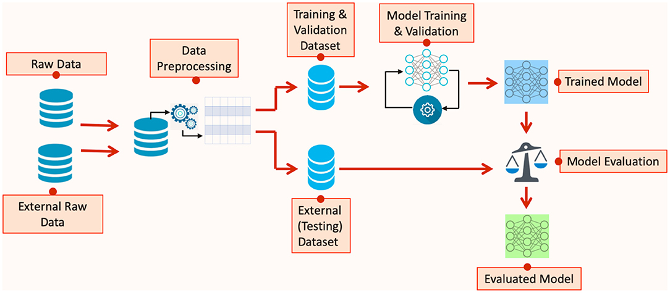
MODELLING
3/21/2024 Annual Review
9

Slide 10
RESULTS
The results of demonstrate significant advancements in forecasting disease outbreaks and understanding epidemiological trends. These models provide valuable insights into the spatial and temporal patterns of disease spread, enabling public health authorities and policymakers to implement timely interventions, allocate resources efficiently, and mitigate the impact of the pandemic.
Demo Link
3/21/2024 Annual Review
10

